Slide 1
Lab 2: Mixed-effects models
April 5, 2018

Slide 2
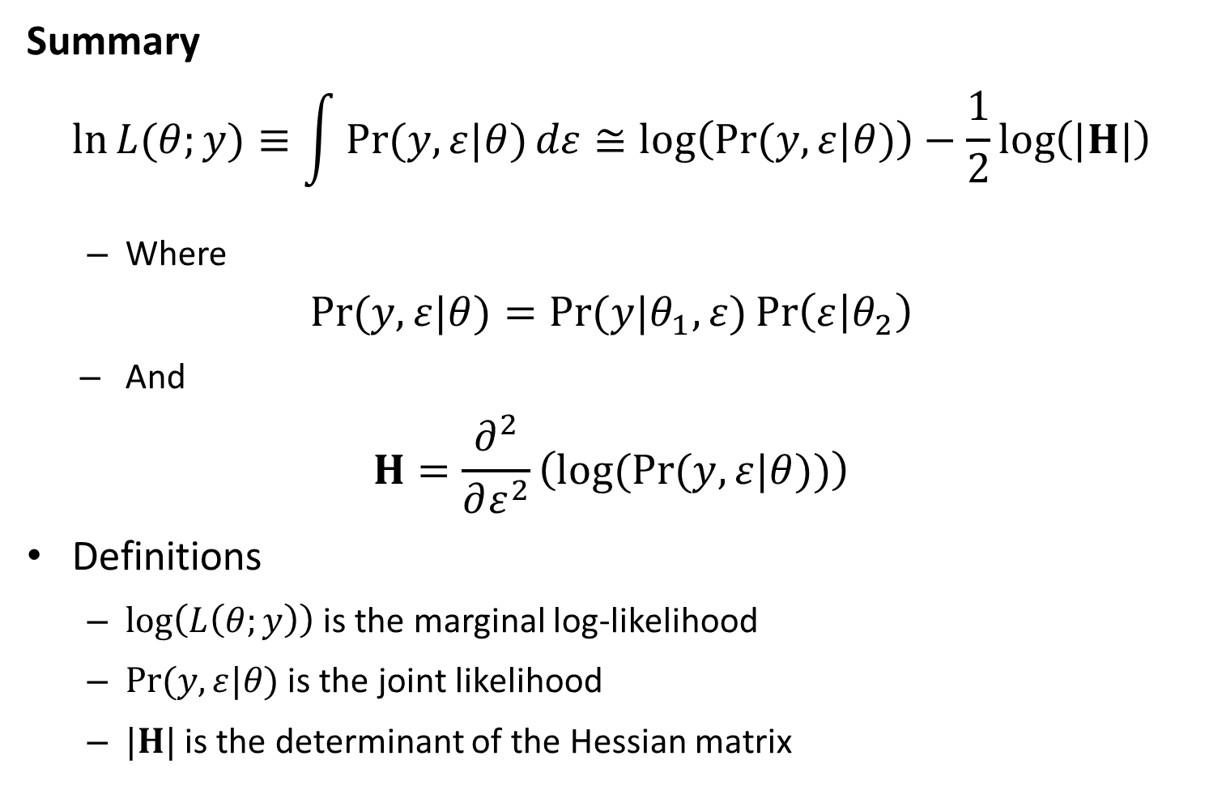
Likelihood statistics
Summary
$$\ln{L{(θ;y)}}≡\int{\operatorname{Pr}{(y,ε|θ)}dε}≅\log\left(\operatorname{Pr}{(y,ε|θ)}\right)−\frac{1}{2}\log\left(|H|\right)$$
Where
$$\operatorname{Pr}{(y,ε|θ)}=\operatorname{Pr}{(y|θ_{1},ε)}\operatorname{Pr}\left(ε | θ_{2}\right)$$
And
$$H=\frac{∂^{2}}{∂ε^{2}}\left(log(Pr{(y,ε|θ))}\right)$$
Definitions
$\log\left(L\left(θ;y\right)\right)$ is the marginal log-likelihood
$\operatorname{Pr}{(y,ε|θ)}$ is the joint likelihood
$|H|$ is the determinant of the Hessian matrix

Slide 3
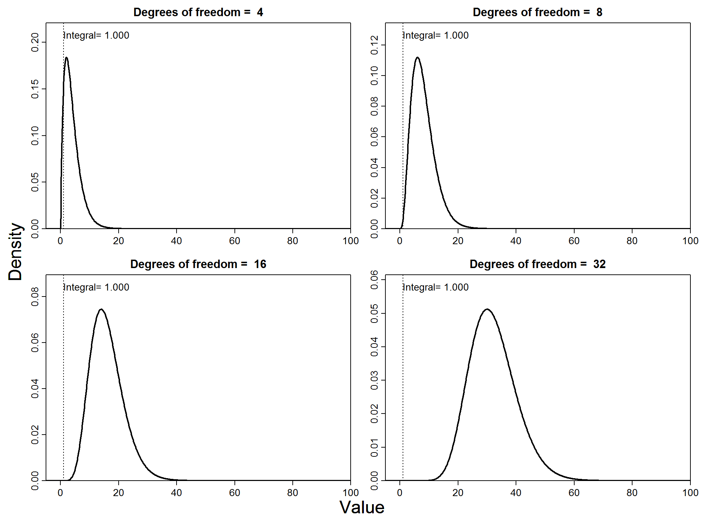

Slide 4
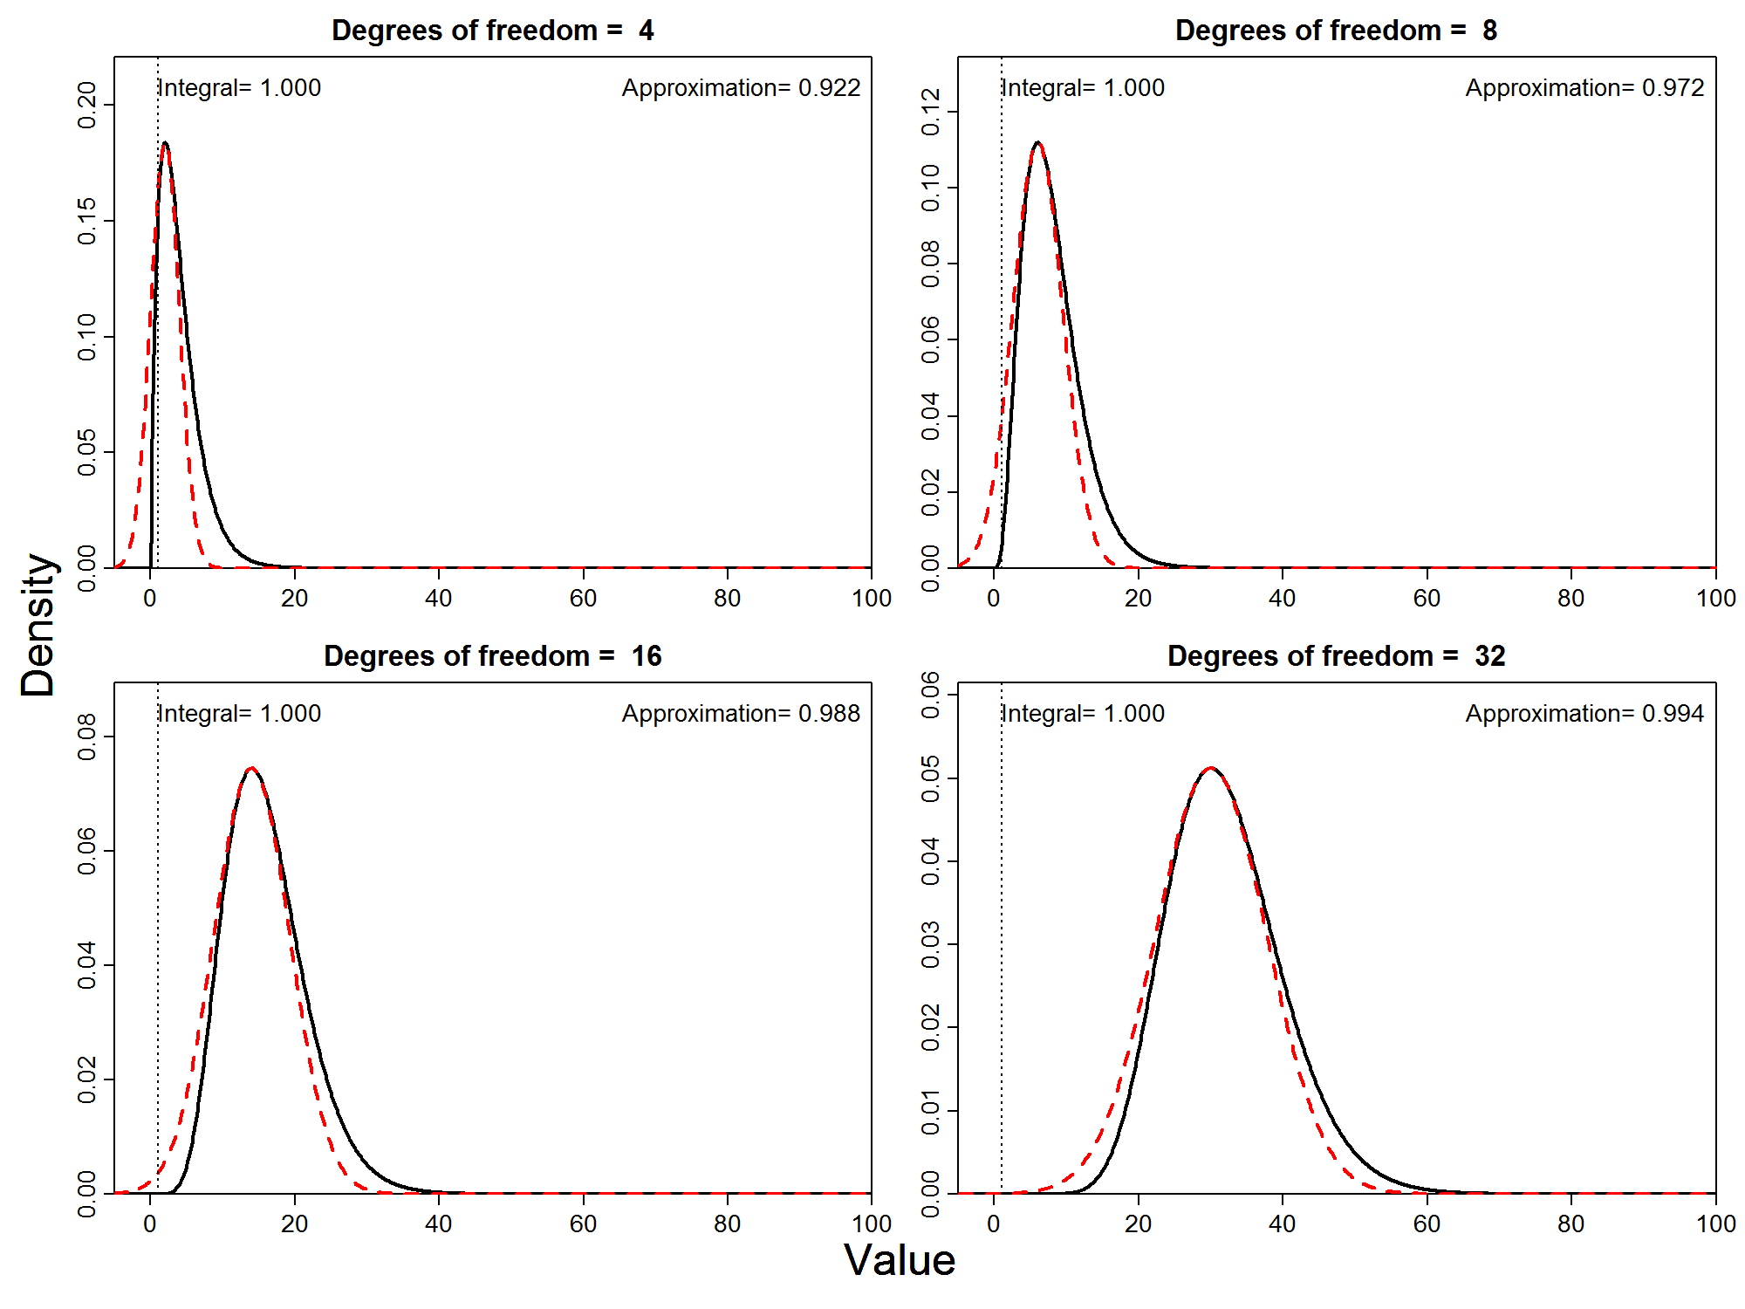

Slide 5
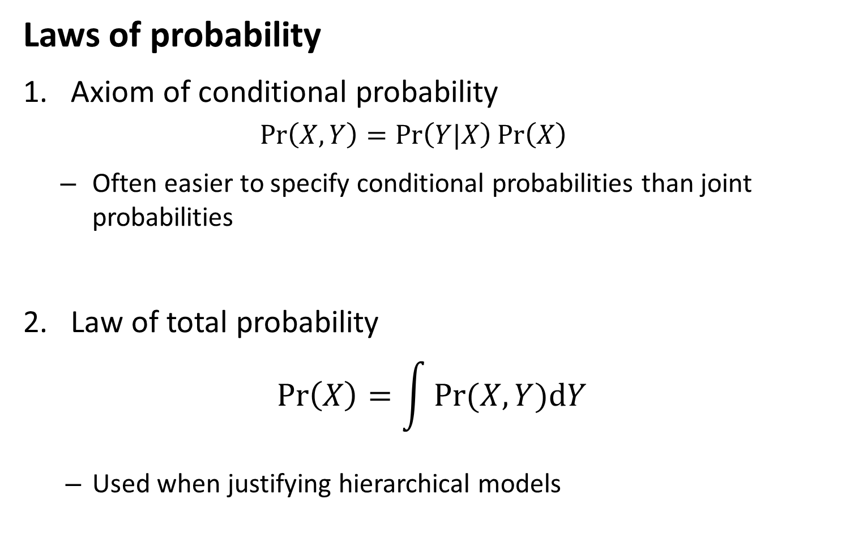
Mixed-effects models
Laws of probability
Axiom of conditional probability
$$\operatorname{Pr}\left(X,Y\right)=\operatorname{Pr}\left(Y|X\right)\operatorname{Pr}\left(X\right)$$
Often easier to specify conditional probabilities than joint probabilities
Law of total probability
$$\operatorname{Pr}\left(X\right)=\int{Pr⁡(X,Y)dY}$$
Used when justifying hierarchical models

Slide 6
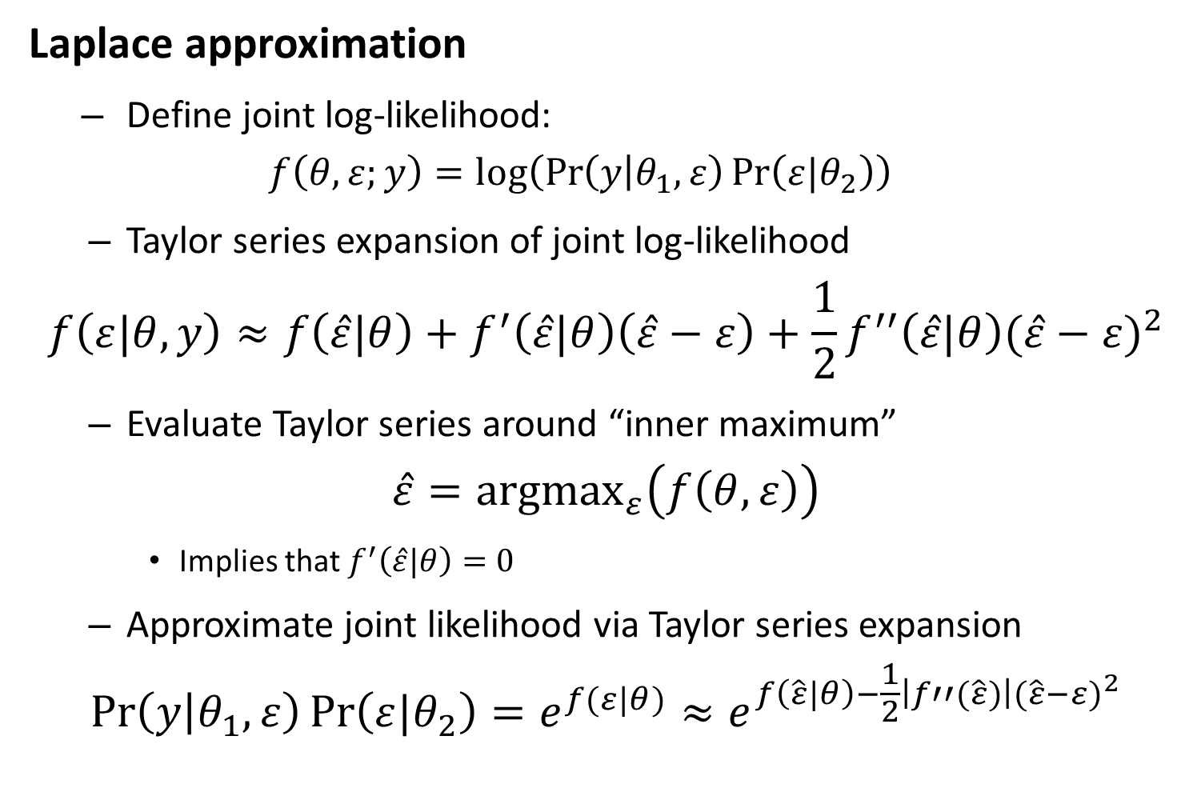
Likelihood statistics
Laplace approximation
Define joint log-likelihood:
$$f\left(θ,ε;y\right)=log⁡\left(\operatorname{Pr}\left(y | θ_{1},ε\right)\operatorname{Pr}\left(ε|θ_{2}\right)\right)$$
Taylor series expansion of joint log-likelihood
$$f\left(ε|θ,y\right)≈f\left(\hat{ε}|θ\right)+f^{′}\left(\hat{ε}|θ\right)\left(\hat{ε}−ε\right)+\frac{1}{2}f^{′′}\left(\hat{ε}|θ\right){(\hat{ε}−ε)}^{2}$$
Evaluate Taylor series around “inner maximum”
$$\hat{ε}={argmax}_{ε}\left(f\left(θ,ε\right)\right)$$
Implies that $f^{′}\left(\hat{ε}|θ\right)=0$
Approximate joint likelihood via Taylor series expansion
$$\operatorname{Pr}\left(y | θ_{1},ε\right)\operatorname{Pr}\left(ε|θ_{2}\right)=e^{f(ε|θ)}≈e^{f\left(\hat{ε}|θ\right)−\frac{1}{2}\left|f′′(\hat{ε})\right|{(\hat{ε}−ε)}^{2}}$$

Slide 7
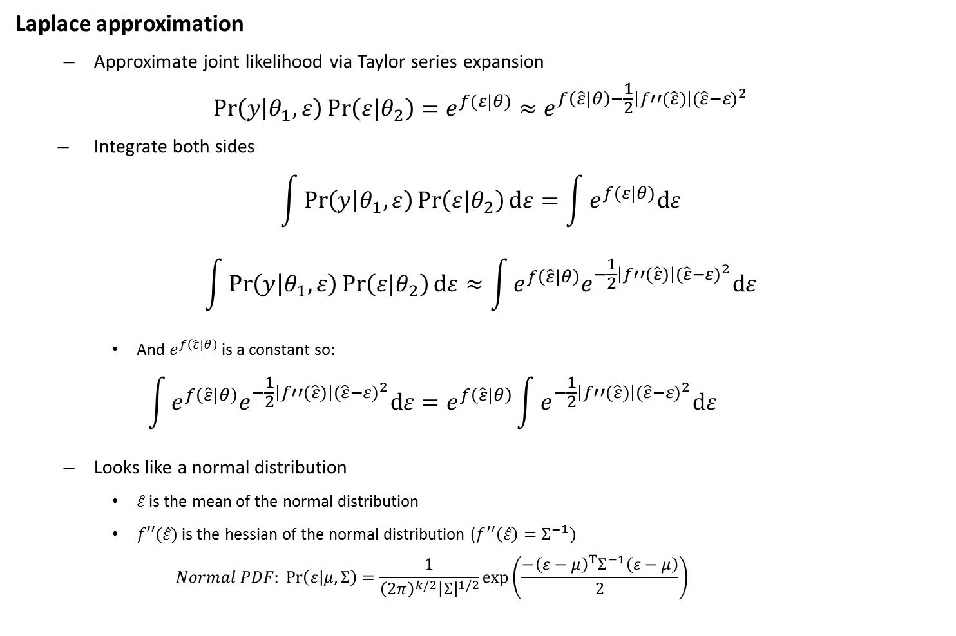
Likelihood statistics
Laplace approximation
Approximate joint likelihood via Taylor series expansion
$$\operatorname{Pr}\left(y | θ_{1},ε\right)\operatorname{Pr}\left(ε|θ_{2}\right)=e^{f(ε|θ)}≈e^{f\left(\hat{ε}|θ\right)−\frac{1}{2}\left|f′′(\hat{ε})\right|{(\hat{ε}−ε)}^{2}}$$
Integrate both sides
$$\int{\operatorname{Pr}\left(y | θ_{1},ε\right)\operatorname{Pr}\left(ε|θ_{2}\right)dε}=\int{e^{f(ε|θ)}dε}$$
$$\int{\operatorname{Pr}\left(y | θ_{1},ε\right)\operatorname{Pr}\left(ε|θ_{2}\right)dε}≈\int{e^{f\left(\hat{ε}|θ\right)}e^{−\frac{1}{2}\left|f′′(\hat{ε})\right|{(\hat{ε}−ε)}^{2}}dε}$$
And $e^{f\left(\hat{ε}|θ\right)}$ is a constant so:
$$\int{e^{f\left(\hat{ε}|θ\right)}e^{−\frac{1}{2}\left|f′′(\hat{ε})\right|{(\hat{ε}−ε)}^{2}}dε}=e^{f\left(\hat{ε}|θ\right)}\int{e^{−\frac{1}{2}\left|f′′(\hat{ε})\right|{(\hat{ε}−ε)}^{2}}dε}$$
Looks like a normal distribution
$\hat{ε}$ is the mean of the normal distribution
$f′′(\hat{ε})$ is the hessian of the normal distribution ($f^{′′}\left(\hat{ε}\right)=Σ^{−1})$
$$Normal PDF: \operatorname{Pr}\left(ε | μ,Σ\right)=\frac{1}{{\left(2π\right)}^{k/2}{\left|Σ\right|}^{1/2}}exp⁡\left(\frac{−{\left(ε−μ\right)}^{T}Σ^{−1}\left(ε−μ\right)}{2}\right)$$

Slide 8

Likelihood statistics
Chi-squared example
$$X\sim Chi.Squared(k)$$
$$\operatorname{Pr}\left(X=x\right)∝x^{\frac{k}{2}−1}e^{\frac{−x}{2}}$$
Defining the log-likelihood
$$\log\left(\operatorname{Pr}\left(x\right)\right)∝f(x)$$
Taking derivatives:
$$f\left(x\right)∝\left(\frac{k}{2}−1\right)\log\left(x\right)−\frac{x}{2}$$
$$f′\left(x\right)∝\left(\frac{k}{2}−1\right)x^{−1}−\frac{1}{2}$$
$$f′′\left(x\right)∝−\left(\frac{k}{2}−1\right)x^{−2}$$
Solving for mode and Hessian:
$$f^{′}\left(x\right)=0 → \hat{x}=k−2$$
$$f′′\left(\hat{x}\right)=−\left(\frac{1}{2\left(k−2\right)}\right)$$
Hence:
$$\operatorname{Pr}{(x)}∝Normal(k−2, 2\left(k−2\right))$$

Slide 9
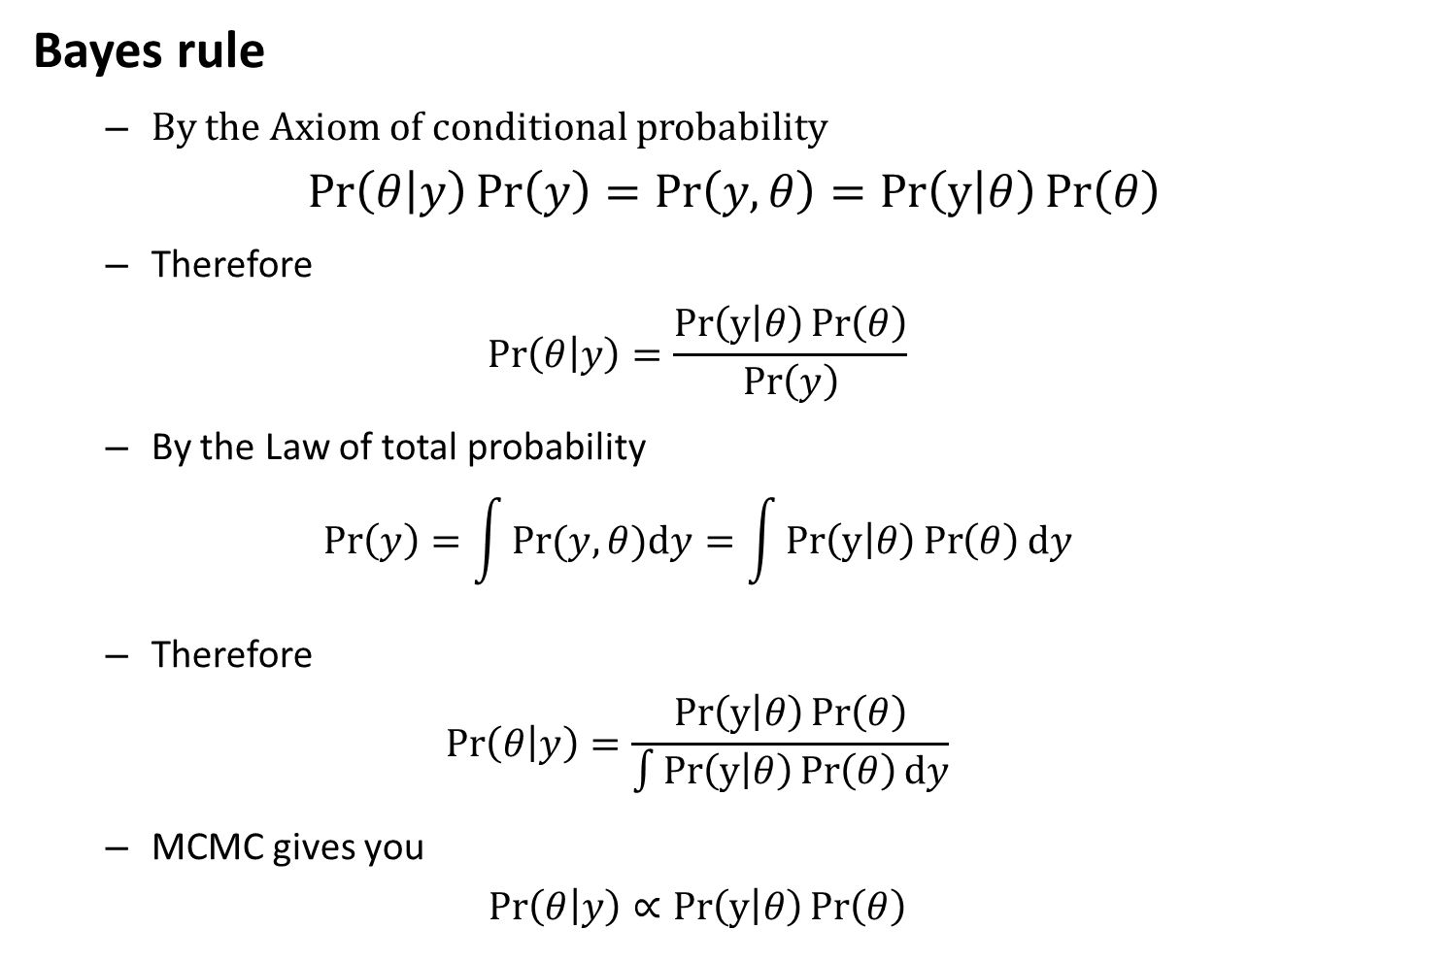
Mixed-effects models
Bayes rule
By the Axiom of conditional probability
$$\operatorname{Pr}\left(θ | y\right)\operatorname{Pr}\left(y\right)=\operatorname{Pr}\left(y,θ\right)=Pr\left(y | θ\right)\operatorname{Pr}\left(θ\right)$$
Therefore
$$\operatorname{Pr}\left(θ | y\right)=\frac{Pr\left(y | θ\right)\operatorname{Pr}\left(θ\right)}{\operatorname{Pr}\left(y\right)}$$
By the Law of total probability
$$\operatorname{Pr}\left(y\right)=\int{Pr⁡(y,θ)dy}=\int{Pr\left(y | θ\right)\operatorname{Pr}\left(θ\right)dy}$$
Therefore
$$\operatorname{Pr}\left(θ | y\right)=\frac{Pr\left(y | θ\right)\operatorname{Pr}\left(θ\right)}{\int{Pr\left(y | θ\right)\operatorname{Pr}\left(θ\right)dy}}$$
MCMC gives you
$$\operatorname{Pr}\left(θ | y\right)∝Pr\left(y | θ\right)\operatorname{Pr}\left(θ\right)$$

Slide 10
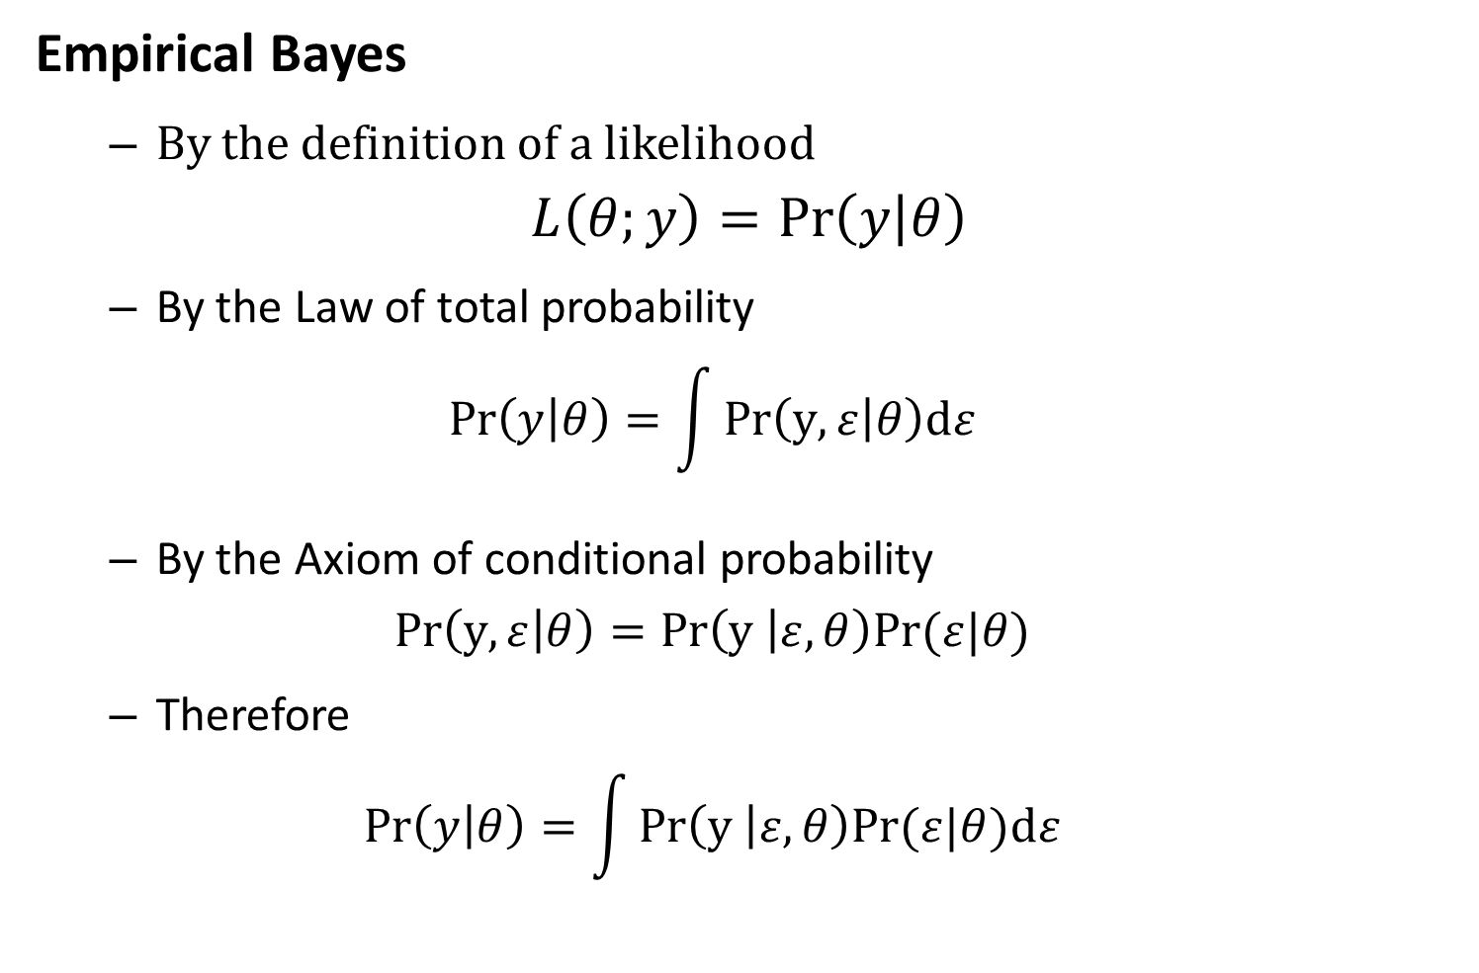
Mixed-effects models
Empirical Bayes
By the definition of a likelihood
$$L\left(θ;y\right)=\operatorname{Pr}\left(y | θ\right)$$
By the Law of total probability
$$\operatorname{Pr}\left(y | θ\right)=\int{Pr\left(y,ε | θ\right)dε}$$
By the Axiom of conditional probability
$$Pr\left(y,ε | θ\right)=Pr\left(y | ε,θ\right)Pr⁡(ε|θ)$$
Therefore
$$\operatorname{Pr}\left(y | θ\right)=\int{Pr\left(y | ε,θ\right)Pr⁡(ε|θ)dε}$$

Slide 11
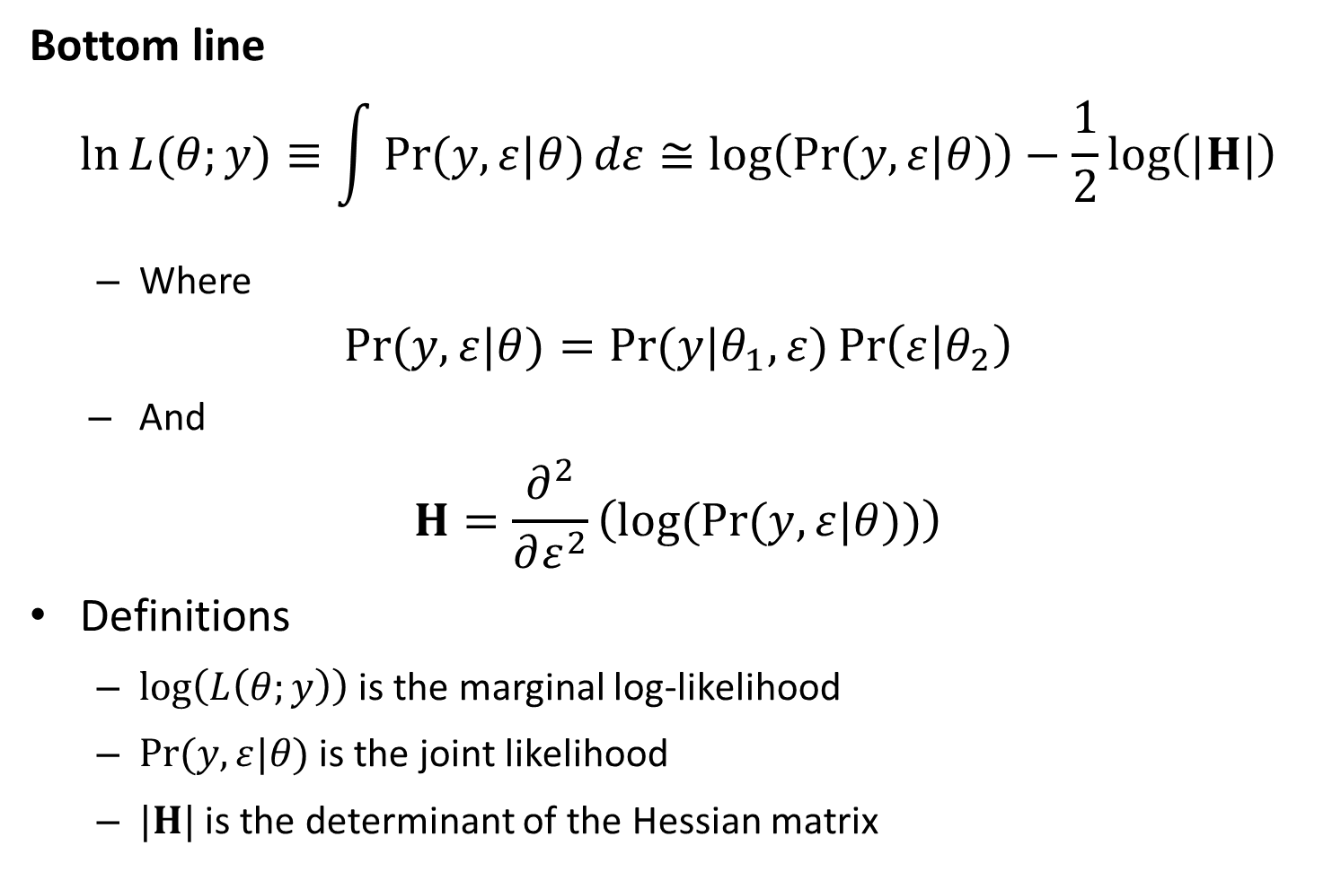
Likelihood statistics
Bottom line
$$\ln{L{(θ;y)}}≡\int{\operatorname{Pr}{(y,ε|θ)}dε}≅\log\left(\operatorname{Pr}{(y,ε|θ)}\right)−\frac{1}{2}\log\left(|H|\right)$$
Where
$$\operatorname{Pr}{(y,ε|θ)}=\operatorname{Pr}{(y|θ_{1},ε)}\operatorname{Pr}\left(ε | θ_{2}\right)$$
And
$$H=\frac{∂^{2}}{∂ε^{2}}\left(log(Pr{(y,ε|θ))}\right)$$
Definitions
$\log\left(L\left(θ;y\right)\right)$ is the marginal log-likelihood
$\operatorname{Pr}{(y,ε|θ)}$ is the joint likelihood
$|H|$ is the determinant of the Hessian matrix

Slide 12
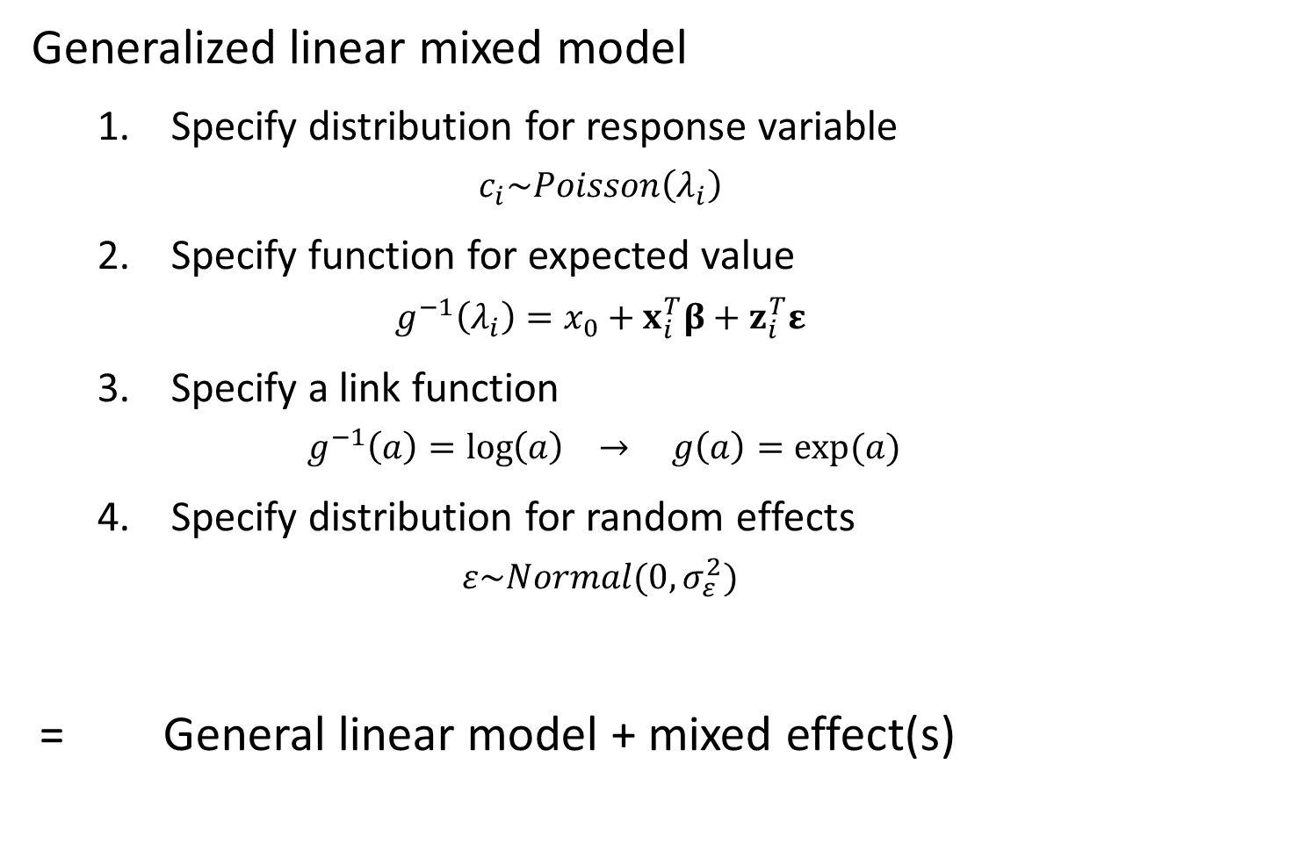
Mixed-effects models
Generalized linear mixed model
Specify distribution for response variable
$$c_{i}\sim Poisson\left(λ_{i}\right)$$
Specify function for expected value
$$g^{−1}\left(λ_{i}\right)=x_{0}+x_{i}^{T}β+z_{i}^{T}ε$$
Specify a link function
$$g^{−1}\left(a\right)=\log\left(a\right) → g\left(a\right)=exp⁡(a)$$
Specify distribution for random effects
$$ε\sim Normal(0,σ_{ε}^{2})$$
= General linear model + mixed effect(s)

Slide 13
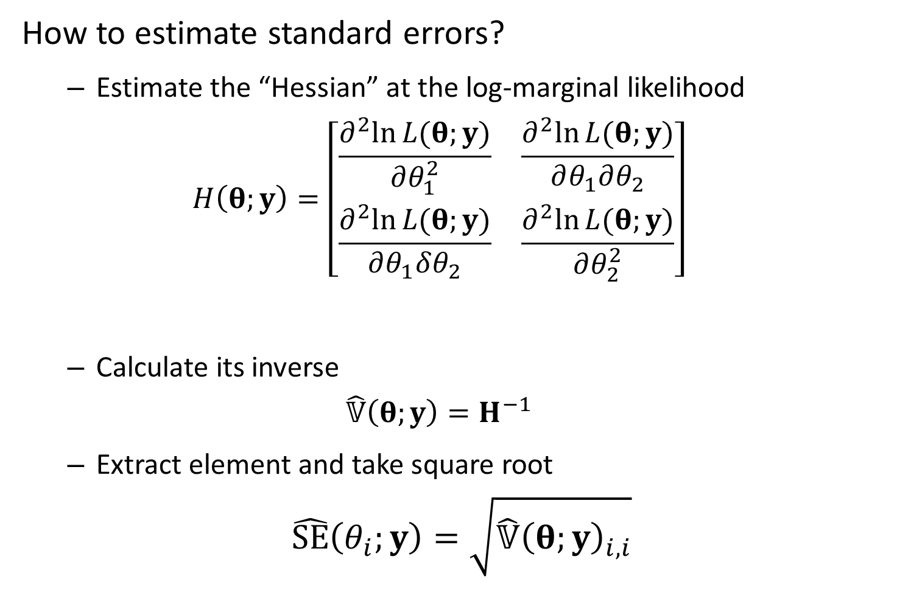
Mixed-effects models
How to estimate standard errors?
Estimate the “Hessian” at the log-marginal likelihood
$$H\left(θ;y\right)=\left[\begin{matrix}\frac{∂^{2}ln⁡L(θ;y)}{∂θ_{1}^{2}} & \frac{∂^{2}ln⁡L(θ;y)}{∂θ_{1}∂θ_{2}} \\ \frac{∂^{2}ln⁡L(θ;y)}{∂θ_{1}δθ_{2}} & \frac{∂^{2}ln⁡L(θ;y)}{∂θ_{2}^{2}}\end{matrix}\right]$$
Calculate its inverse
$$\hat{𝕍}\left(θ;y\right)=H^{−1}$$
Extract element and take square root
$$\hat{SE}\left(θ_{i};y\right)=\sqrt{\hat{𝕍}{\left(θ;y\right)}_{i,i}}$$

Slide 14
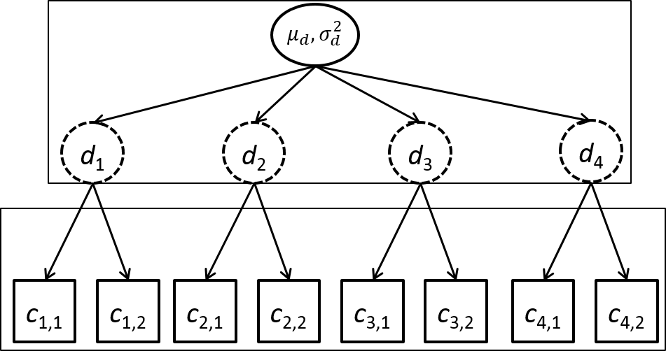

Mixed-effects models
Example – Hierarchical count samples
$$log⁡(d_{j})\sim Normal(μ_{d},σ_{d}^{2})$$
$$c_{i,j}\sim Poisson(d_{j})$$
Counts
4 sites
2 observations/site
3 fixed effects
4 random effects

Slide 15
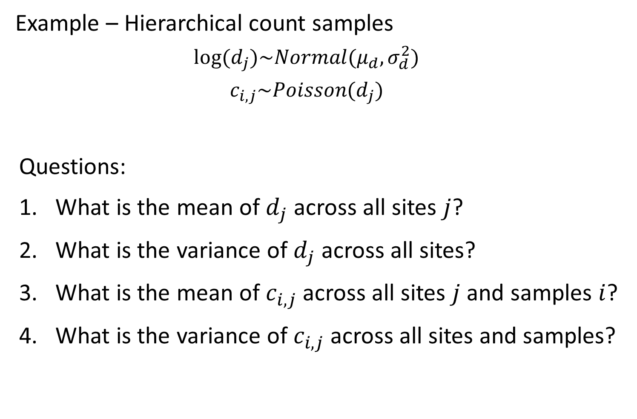
Mixed-effects models
Example – Hierarchical count samples
$$log⁡(d_{j})\sim Normal(μ_{d},σ_{d}^{2})$$
$$c_{i,j}\sim Poisson(d_{j})$$
Questions:
What is the mean of $d_{j}$ across all sites $j$?
What is the variance of $d_{j}$ across all sites?
What is the mean of $c_{i,j}$ across all sites $j$ and samples $i$?
What is the variance of $c_{i,j}$ across all sites and samples?

Slide 16
Mixed-effects models
Simulating data
[See R code]

Slide 17
Mixed-effects models
Fit using R
Using lme4 package
formula: way to specify model
Linear model – lm(formula= … )
Count ~ 0 + factor(Site)
“Count” – response variable
“0” – Don’t include intercept
“factor(Site)” – Include a fixed effect for each site
Linear mixed model – lm(formula = … | … )
Count ~ ( 1 | factor(Site))
“( 1 | factor(Site) )” – Include a random effect for each site

Slide 18
Mixed-effects models
Fit using R
[See R code]

Slide 19
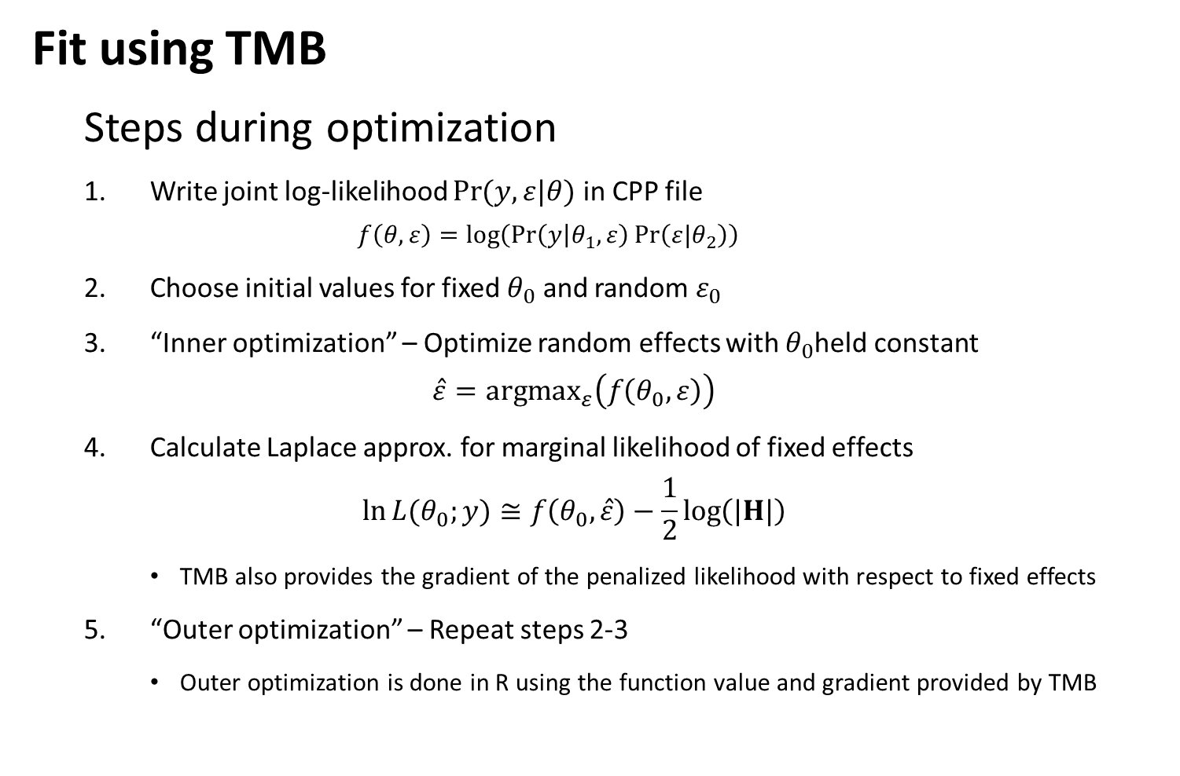
Mixed-effects models
Fit using TMB
Steps during optimization
Write joint log-likelihood $\operatorname{Pr}{(y,ε|θ)}$ in CPP file
$$f\left(θ,ε\right)=log⁡\left(\operatorname{Pr}\left(y | θ_{1},ε\right)\operatorname{Pr}\left(ε|θ_{2}\right)\right)$$
Choose initial values for fixed $θ_{0}$ and random $ε_{0}$
“Inner optimization” – Optimize random effects with $θ_{0}$held constant
$$\hat{ε}={argmax}_{ε}\left(f\left(θ_{0},ε\right)\right)$$
Calculate Laplace approx. for marginal likelihood of fixed effects
$$\ln{L{(θ_{0};y)}}≅f\left(θ_{0},\hat{ε}\right)−\frac{1}{2}\log\left(|H|\right)$$
TMB also provides the gradient of the penalized likelihood with respect to fixed effects
“Outer optimization” – Repeat steps 2-3
Outer optimization is done in R using the function value and gradient provided by TMB

Slide 20
Mixed-effects models
Fit using TMB
[See R code]

Slide 21
Mixed-effects models
Benefits of using linear mixed models
Separate estimate of measurement and between-site variability
Include covariates for either one
Improved precision
“Shrinkage”
Draw-backs
Biased if random effects aren’t “exchangeable”

Slide 22
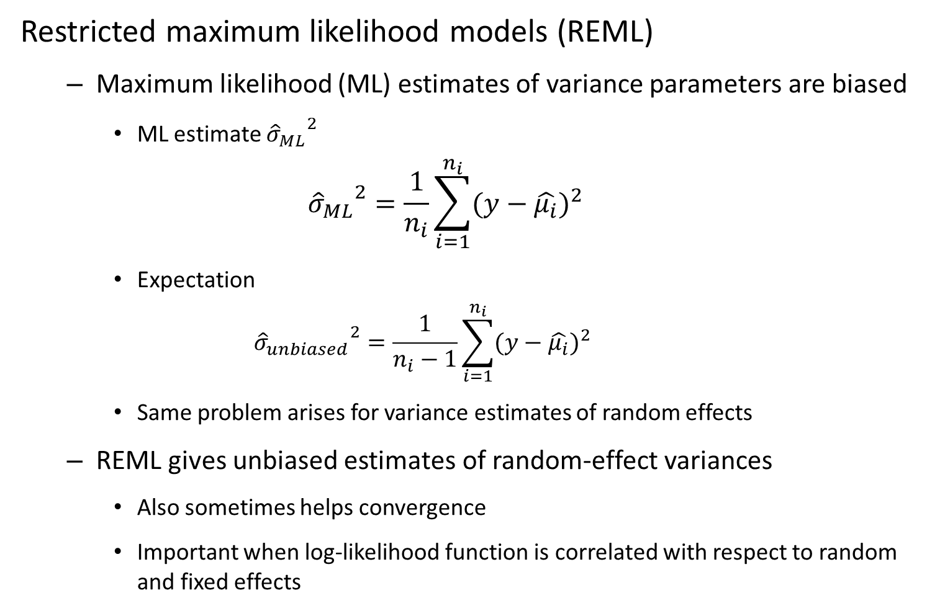
Mixed-effects models
Restricted maximum likelihood models (REML)
Maximum likelihood (ML) estimates of variance parameters are biased
ML estimate ${{\hat{σ}}_{ML}}^{2}$
$${{\hat{σ}}_{ML}}^{2}=\frac{1}{n_{i}}\sum_{i=1}^{n_{i}}{(y−{\hat{μ_{i}})}^{2}}$$
Expectation
$${{\hat{σ}}_{unbiased}}^{2}=\frac{1}{n_{i}−1}\sum_{i=1}^{n_{i}}{(y−{\hat{μ_{i}})}^{2}}$$
Same problem arises for variance estimates of random effects
REML gives unbiased estimates of random-effect variances
Also sometimes helps convergence
Important when log-likelihood function is correlated with respect to random and fixed effects
Notes:
MLEs guaranteed to be consistent, but not unbiased. The expectation for a finite sample may be biased
Text book example—variance of a linear model
Mean is being systematically shrunk towards the mean of the data, rather than the true value, so they’ll always be smaller than the true value
So we need to increase the variance slightly to account for that
The same problem arises in random effects variances
The variances of the random effects are also biased slightly low.
REML was originally a way of analytically dealing with that bias in linear models, but it’s not clear how to do that in more complex models.
But, we can always do something like that by integrating across the non-variance fixed effects.

Slide 23
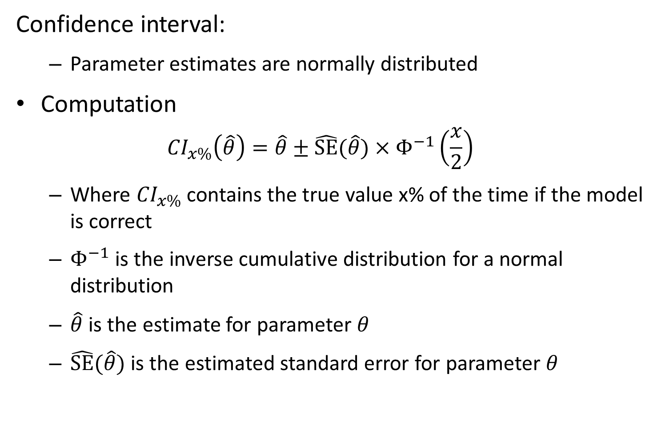
Confidence interval:
Parameter estimates are normally distributed
Computation
$${CI}_{x\%}\left(\hat{θ}\right)=\hat{θ}±\hat{SE}(\hat{θ})×Φ^{−1}\left(\frac{x}{2}\right)$$
Where ${CI}_{x\%}$ contains the true value x% of the time if the model is correct
$Φ^{−1}$ is the inverse cumulative distribution for a normal distribution
$\hat{θ}$ is the estimate for parameter $θ$
$\hat{SE}(\hat{θ})$ is the estimated standard error for parameter $θ$

Slide 24
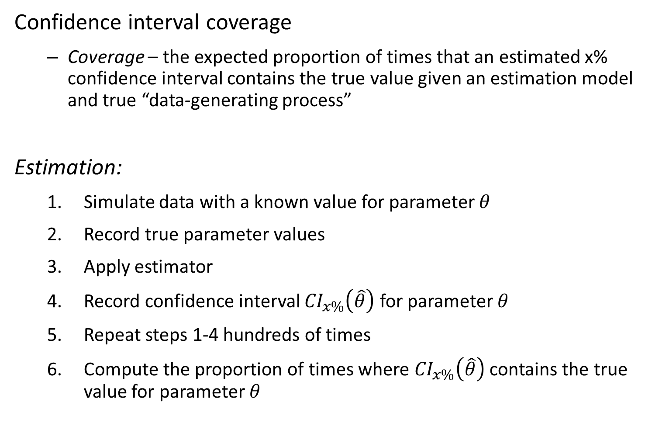
Confidence interval coverage
Coverage – the expected proportion of times that an estimated x% confidence interval contains the true value given an estimation model and true “data-generating process”
Estimation:
Simulate data with a known value for parameter $θ$
Record true parameter values
Apply estimator
Record confidence interval ${CI}_{x\%}\left(\hat{θ}\right)$ for parameter $θ$
Repeat steps 1-4 hundreds of times
Compute the proportion of times where ${CI}_{x\%}\left(\hat{θ}\right)$ contains the true value for parameter $θ$

Slide 25
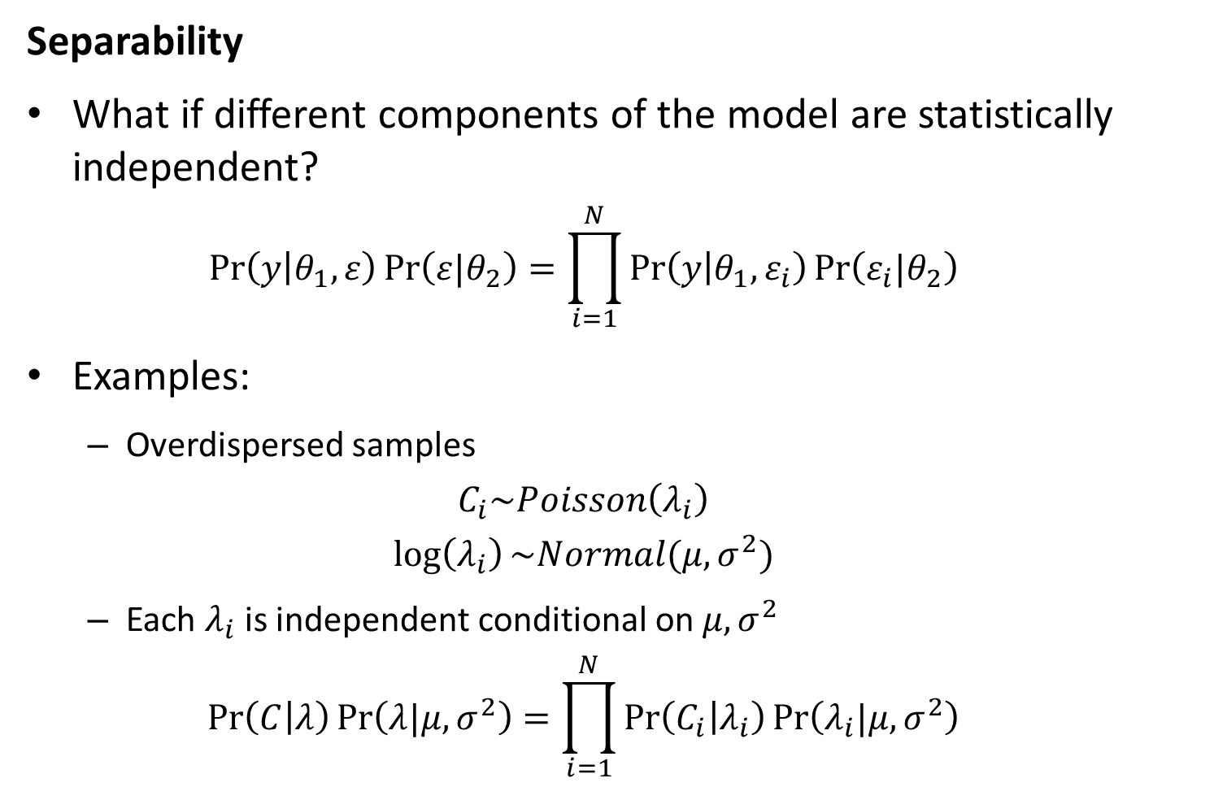
Likelihood statistics
Separability
What if different components of the model are statistically independent?
$$\operatorname{Pr}\left(y | θ_{1},ε\right)\operatorname{Pr}\left(ε|θ_{2}\right)=\prod_{i=1}^{N}{\operatorname{Pr}\left(y | θ_{1},ε_{i}\right)\operatorname{Pr}\left(ε_{i}|θ_{2}\right)}$$
Examples:
Overdispersed samples
$$C_{i}\sim Poisson\left(λ_{i}\right)$$
$$\log\left(λ_{i}\right)\sim Normal(μ,σ^{2})$$
Each $λ_{i}$ is independent conditional on $μ,σ^{2}$
$$\operatorname{Pr}\left(C | λ\right)\operatorname{Pr}\left(λ|μ,σ^{2}\right)=\prod_{i=1}^{N}{\operatorname{Pr}\left(C_{i} | λ_{i}\right)\operatorname{Pr}\left(λ_{i}|μ,σ^{2}\right)}$$

Slide 26
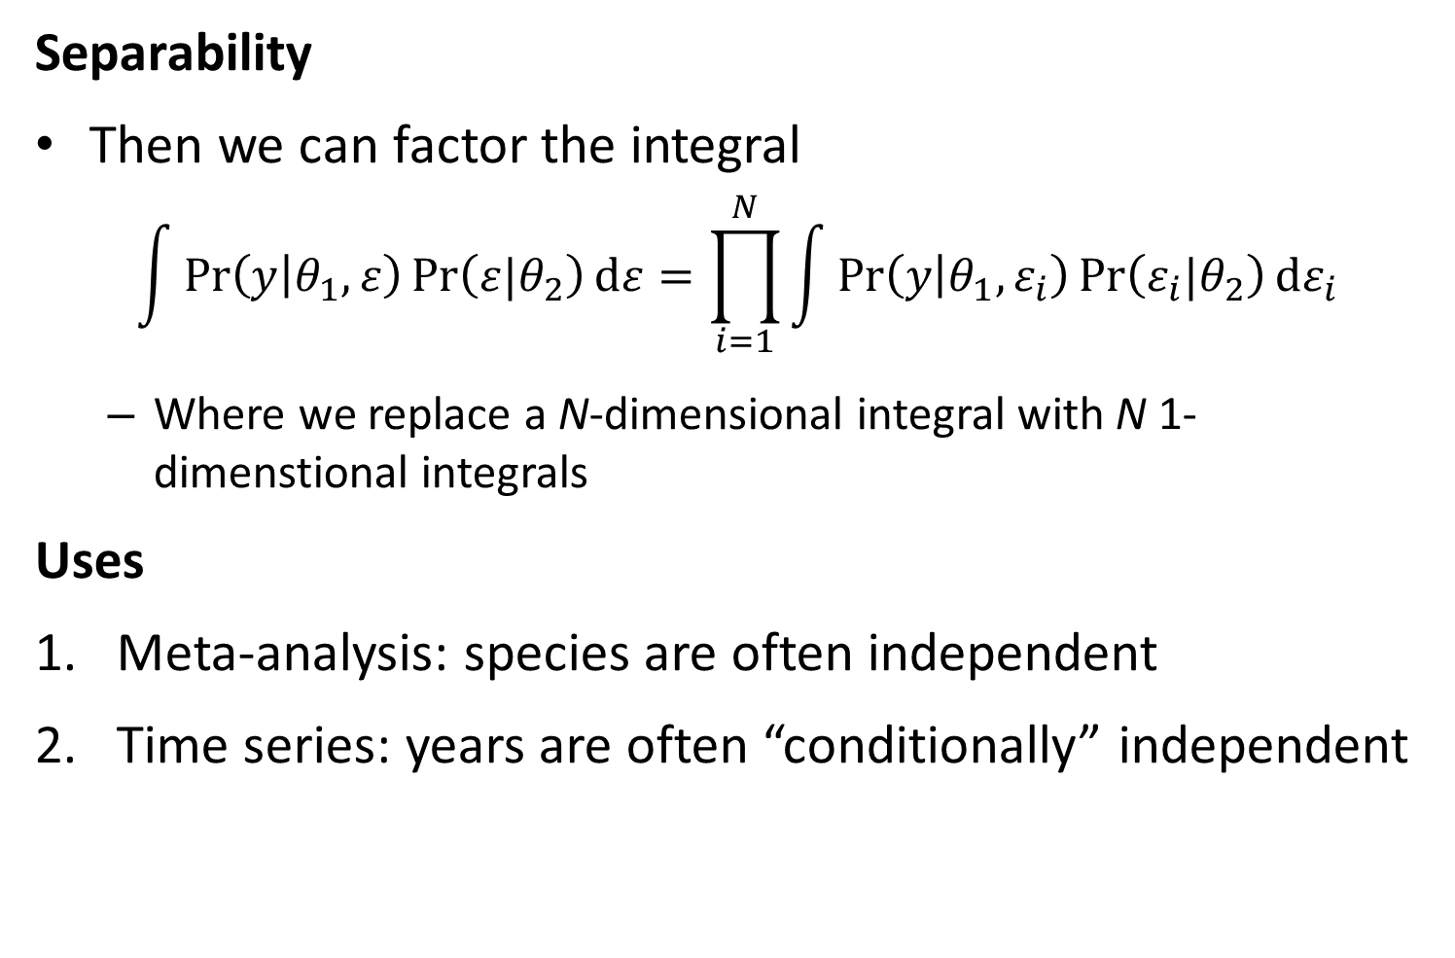
Likelihood statistics
Separability
Then we can factor the integral
$$\int{\operatorname{Pr}\left(y | θ_{1},ε\right)\operatorname{Pr}\left(ε|θ_{2}\right)dε}=\prod_{i=1}^{N}{\int{\operatorname{Pr}\left(y | θ_{1},ε_{i}\right)\operatorname{Pr}\left(ε_{i}|θ_{2}\right)dε_{i}}}$$
Where we replace a N-dimensional integral with N 1-dimenstional integrals
Uses
Meta-analysis: species are often independent
Time series: years are often “conditionally” independent

Slide 27
Mixed-effects models
[Explore “map” argument to TMB]

